Slide 1
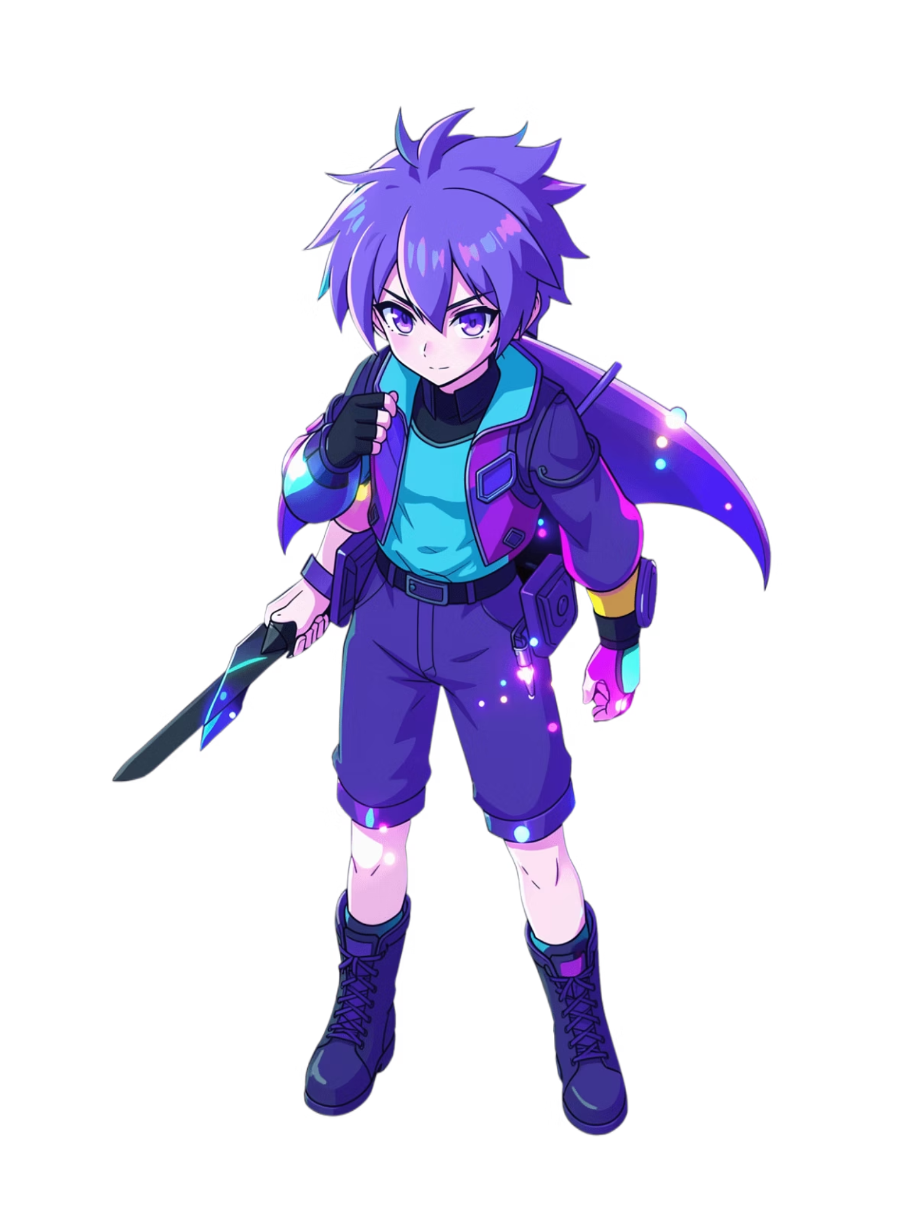
3-MINUTE PROJECT PRESENTATION
Domain-Specific 3DGS Generation
Finetuning DIFFSPLAT for Anime Characters
Exploring how to adapt a powerful 3D Gaussian Splatting diffusion framework to the stylized anime domain — and what we learned from the first attempt.

Slide 2
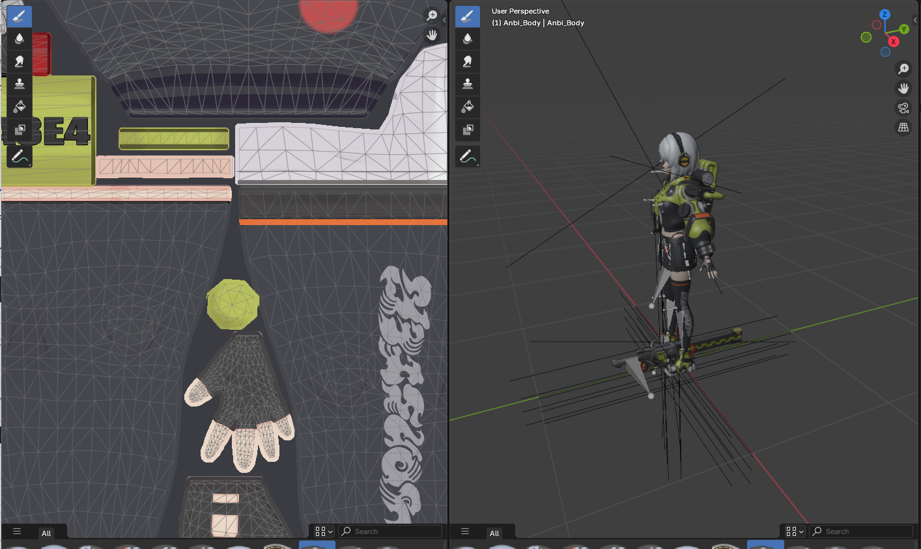
Motivation: High Production Cost & Expertise Gap
High-quality 3D models often take weeks of manual work by skilled artists.
Keeping characters consistent and “on-model” is especially difficult.
Notes:
While 2D generative AI can now produce breathtaking anime illustrations in seconds, the 3D pipeline for this style remains a major bottleneck.
Creating high-quality 3D anime assets currently requires weeks of manual labor by specialized artists to maintain 'on-model' consistency. Our goal is to close this gap: by finetuning a model that already understands 3D geometry, we want to enable the instant conversion of 2D anime characters into 3D assets for games, VR, and digital art.

Slide 3
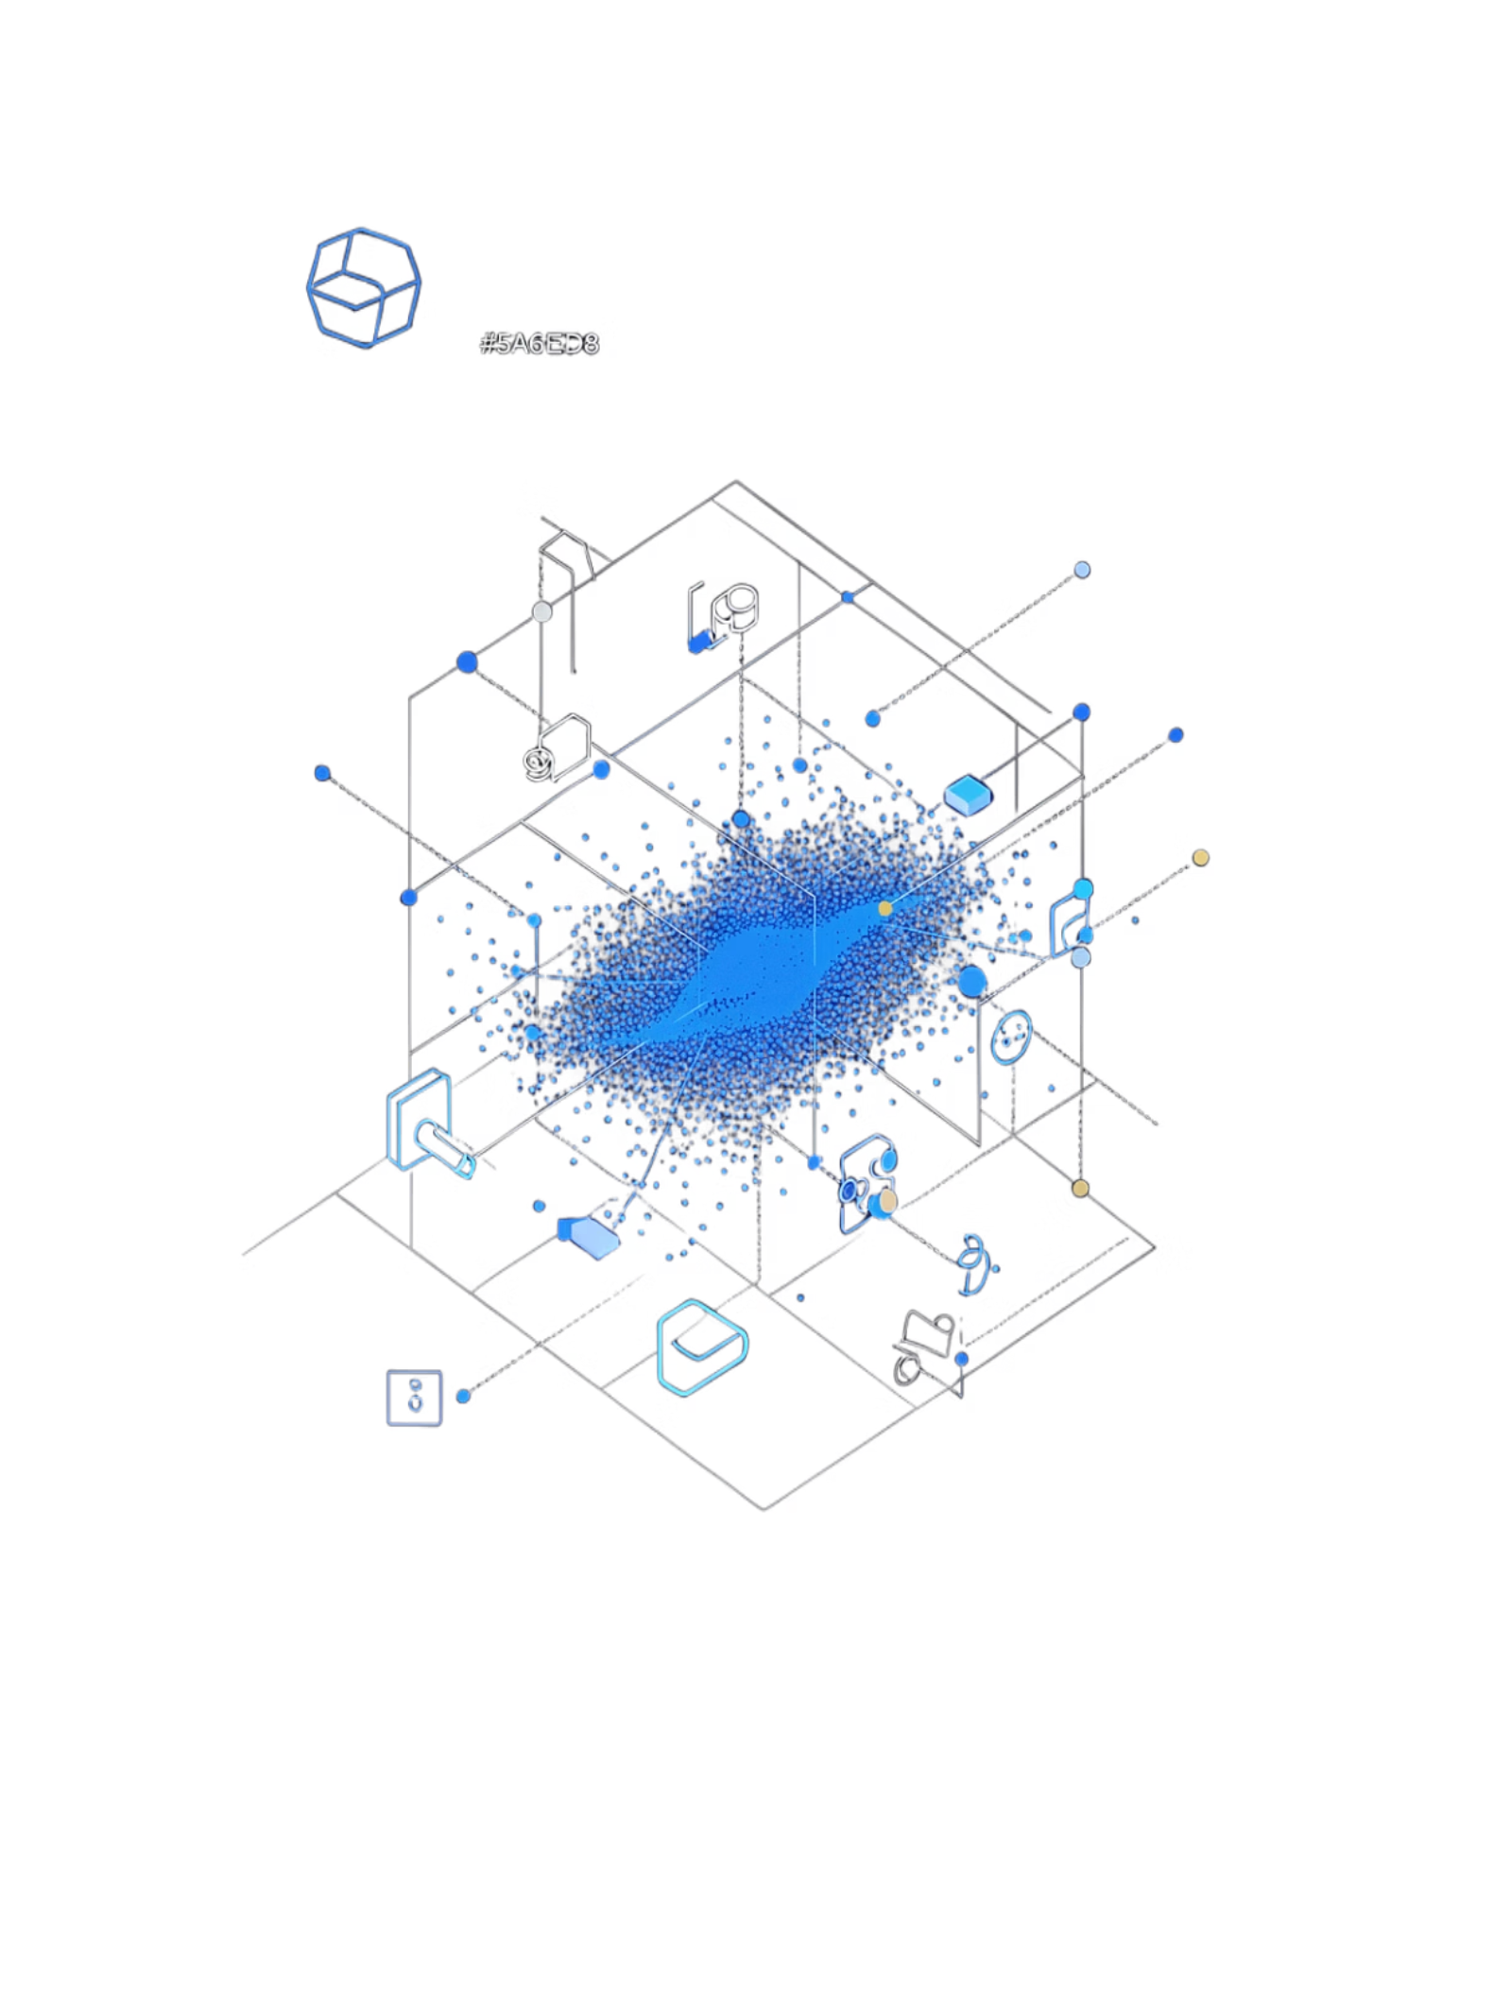



Why DiffSplat?
DiffSplat is a 3D generation framework fine-tuned from pretrained 2D diffusion models, producing Gaussian Splats renderable in ~1–2 seconds.
Strong 2D Priors
Single-Image Conditioning
Built on large pretrained diffusion backbones with rich visual understanding.
Supports generation from one reference image — matching our task exactly.
Practical & Scalable
Faster than optimization-based reconstruction; easier to fine-tune than training a 3D-native model from scratch.

Slide 4
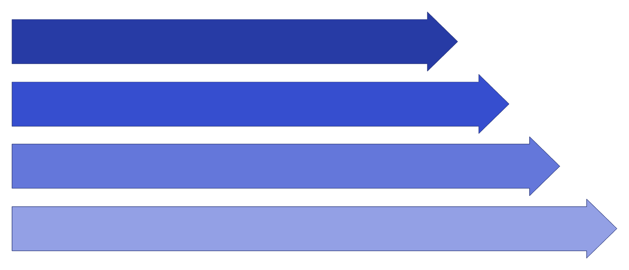
ARCHITECTURE
How DiffSplat Works
Input Image
Diffusion Predicts GS
GSVAE Decode
Render Novel View
DiffSplat is not a pure 2D model — it's a pretrained 2D diffusion backbone adapted with multi-view attention to generate a 3D Gaussian representation decodable and renderable from any angle.

Slide 5
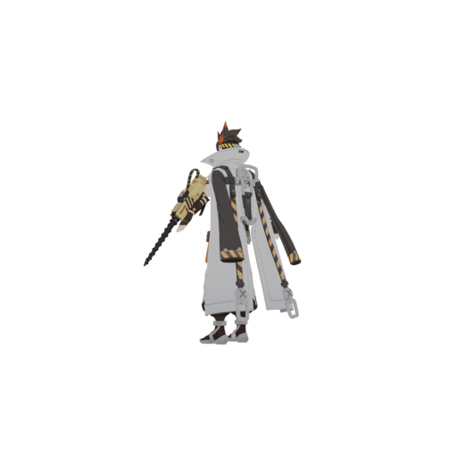
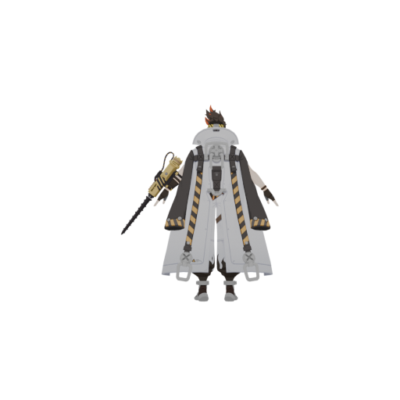
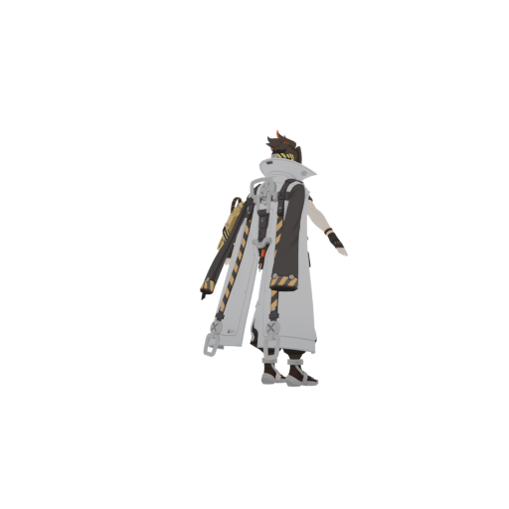
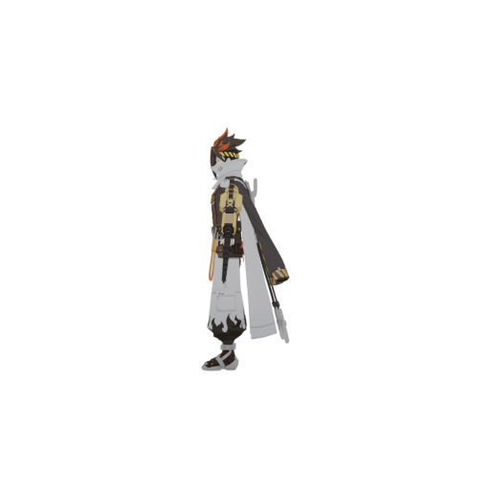
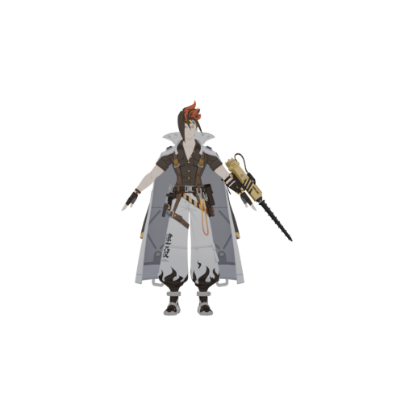
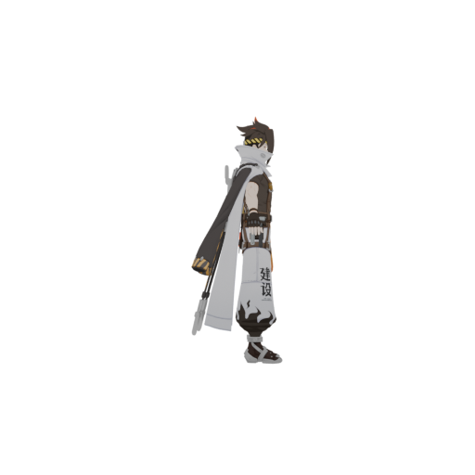
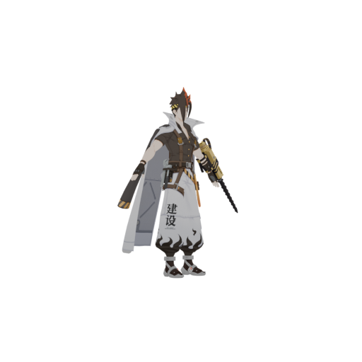
Data Preparation
Pipeline: Automated Blender-to-Dataset workflow.
Scale: 20 unique anime characters.
View Density: 40 multi-view angles per character to ensure 3D coherence.
Objective: Establishing a domain-specific baseline for gsdiff_sd fine-tuning.

Slide 6
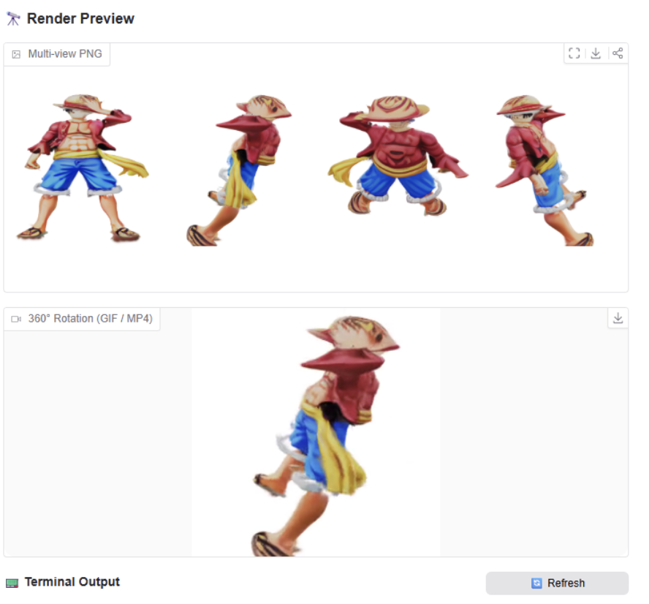
Initial Results: The Anime Problem
What We Expected
DIFFSPLAT excels at photorealistic objects — clean geometry, sharp textures, coherent multi-view consistency.
What We Got
Our One Piece generation reveals the core failure mode:
Muddy, washed-out textures — no vibrant color separation
Indistinct defining features — hair spikes and headband collapse
Broken structural coherence — stylized topology not preserved

Slide 7



ANALYSIS
Why Does It Struggle? (2/2)
Stylized Rendering Cues
Character Complexity
Anime uses flat shading and outlines instead of realistic lighting — providing weaker depth and material signals than natural photos.
Human-like bodies with thin limbs, flowing hair, hats, and clothing folds are far harder than rigid, toy-like objects in the original training data.
Even with fine-tuned diffusion weights, the GSVAE and reconstruction pipeline retain biases from the original object-centric training domain.

Slide 8
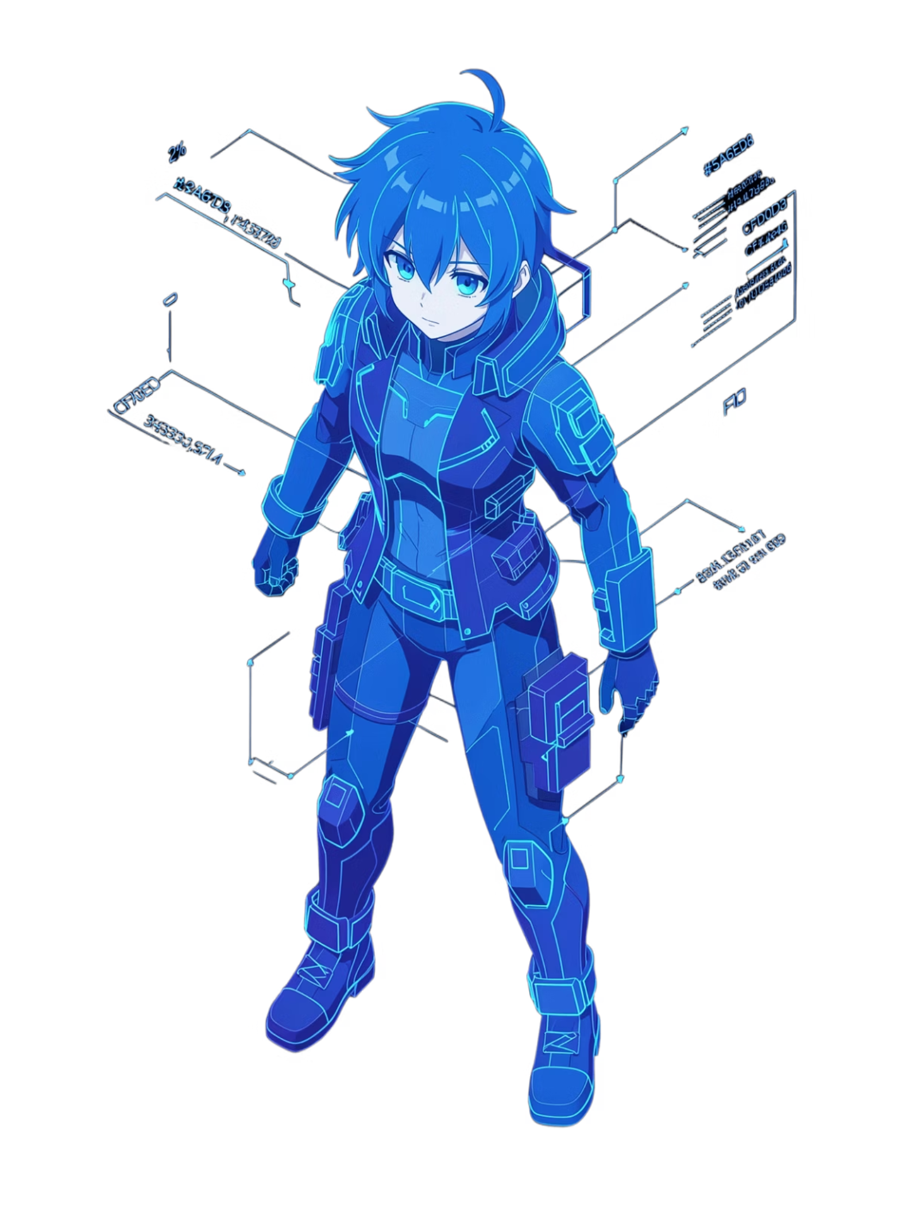


Conclusion & Next Steps
Curate Stylized Dataset
Build a high-quality multi-view anime character dataset with consistent topology and clean annotations.
Geometric Guidance
Apply ControlNet-style conditioning to inject explicit structural priors into the diffusion process.
Notes:
Three way to tackle the problem

